Slide 1
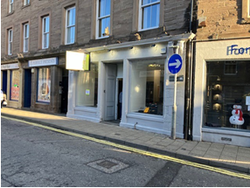
Whitelaw Baikie Figes property details
TO LET
74 CASTLE STREET
FORFAR
DD8 3AD
LOCATION
Forfar is one of the principal towns within Angus, lying 17 miles north of Dundee and 52 miles south of Aberdeen.
The property occupies a prominent position in Castle Street, the town’s main retailing location.
DESCRIPTION
The property comprises a ground floor retail unit within a 3 storey plus attic building.
ACCOMMODATION
The property extends to the following areas and dimensions;
NIA : 655 ft² (60.83m²)
TERMS
The property is offered to the market on the basis of a new full repairing and insuring lease for a period to be agreed.
RENT
Rental offers in the region of £9,250 per annum are invited.
ENERGY PERFORMANCE CERTIFICATE
EPC Band ‘F’
A copy of the Certificate is available on request.
RATEABLE VALUE
We understand the property is entered in the Valuation Roll as follows:
Description: Shop
Rateable Value (26/27) £6,300.
It is possible that a new occupier would benefit from 100% rates relief under SBBS. Further information available on request.
.
PLANNING
We understand that the unit benefits from Class 1A planning consent. Interested parties should make their own enquiries.
LEGAL COSTS
Each party is responsible for their own costs with the tenant responsible for LBBT, Registration and any VAT payable thereon.
VAT
All rents, prices, premiums etc are quoted exclusive of VAT.
ENTRY
Entry is available by on conclusion of legals.
Whitelaw Baikie Figes 81 St Vincent Street
Chartered Surveyors Glasgow G2 5TF
t. 0141 221 6161 www.wbf.co.uk

Slide 2
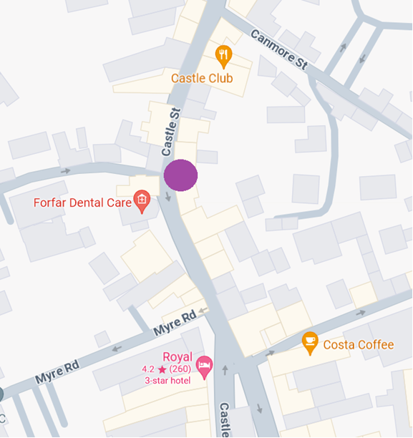
wbf.
whitelaw baikie figes
0141 221 6161
www.wbf.co.uk
MONEY LAUNDERING REGULATIONS
To comply with Money Laundering Regulations we are legally required to undertake due diligence on prospective purchasers/tenants which will at a minimum include proof of identity/address and funding. Applicable documentation will therefore be required on agreement of Heads of Terms.
VIEWING & FURTHER INFORMATION
Access can be arranged through the letting agents;
Tel: 0141 221 6161
Contact: Gavin Anderson
Email: gavin@wbf.co.uk
LOCATION PLAN
.
  :
The information contained within these particulars has been checked, and unless otherwise stated, is understood to be materially correct at the date of publication. After these details have been printed, circumstances may change outwith our control.
Whitelaw Baikie Figes for themselves and for the vendors or lessors of this property whose agents they are give notice that:
the particulars are set out as a general outline only for the guidance of intending purchasers or lessees, and do not constitute part of an offer or contract
all descriptions, dimensions, references to condition and necessary permission for use and occupation, and other details are given without responsibility and any intending purchasers or lessees should not rely on them as statements or representations of fact but must satisfy themselves by inspection or otherwise as to the correctness of each of them and are advised to do so
no person in the employment of Whitelaw Baikie Figes has any authority to give any representation or warranty whatsoever in relation to this property
all prices, rents and premiums quoted are exclusive of VAT at the current rate
any rateable values quoted have been supplied by reference to the relevant local rating authority. Interested lessees are advised to satisfy themselves as to their accuracy.

